Slide 1
Acid Reactions

Slide 2
In this lesson we are going to look at how to:
Identify if a compound is an acid or a base,
Identify if an acid reaction is acid-base, acid-carbonate or acid-metal,
and
Predict the products of an acid reaction.

Slide 3
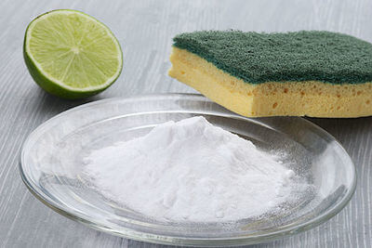
The pH is a measure of how many hydrogen ions are in a solution. The lower that the pH is, the more hydrogen ions that there are!
An acid is a substance with a pH less than 7. Acids tend to be sour, and sting or burn the skin. Some common acids include lemon juice, vinegar and fizzy drinks.
A base is a substance with a pH greater than 7. Bases tend to be bitter, and feel slimy. Some common bases include baking soda, limestone and sodium hydroxide.

Slide 4


Slide 5

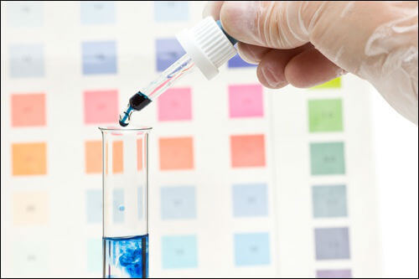
Neutralisation reactions are reactions in which acids and bases react together to form a salt and water.

Slide 6

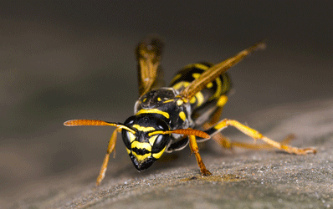
Neutralisation reactions have many practical applications in our everyday lives.
As a few examples, they can be used to control the pH of soil and help plants to grow, to relieve indigestion, to keep a swimming pool clean or to soothe a wasp sting.

Slide 7
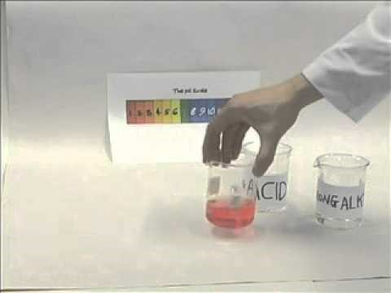

Slide 8
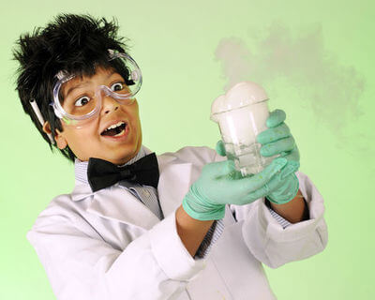
Acid-carbonate reactions occur when acids react with carbonates or hydrogen carbonates to form salt, water and carbon dioxide.
acid + carbonate → salt + carbon dioxide + water
We can test for the carbon dioxide by bubbling it through limewater, because it will make the limewater go cloudy.

Slide 9
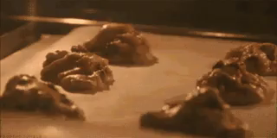
Baking powder is a mixture of an acid and a carbonate that will react slowly to produce bubbles of carbon dioxide, which make your baking feel light and fluffy.
This is an acid-carbonate reaction!

Slide 10
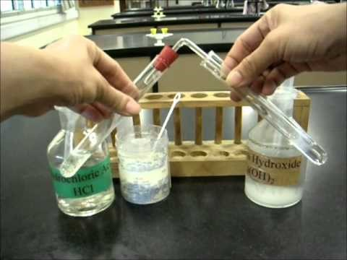

Slide 11
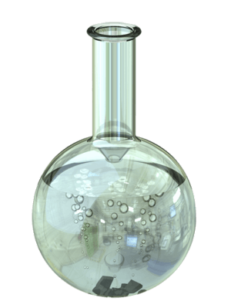
Acid-metal reactions occur when acids react with metal to form a salt and hydrogen gas.
acid + metal → salt + hydrogen gas

Slide 12
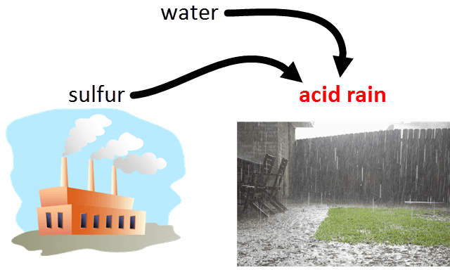
Acid rain will react with metals, such as roofs, fences and vehicles, and cause considerable damage.
Massive amounts of our infrastructure are made of metal, so it is vital that we try to reduce the pollution that causes acid rain!

Slide 13
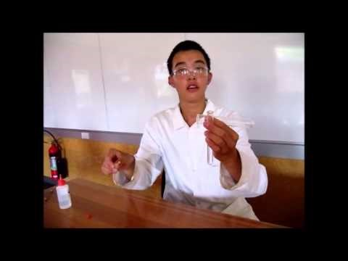

Slide 14
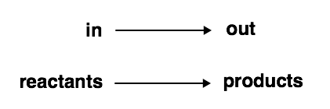
Word equations may seem daunting but they need to be completed to understand acid reactions.
You just need to write the reactants, use an arrow (to show the direction of the reaction), and then write the products.

Slide 15
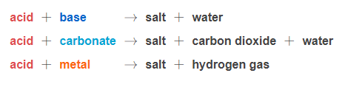
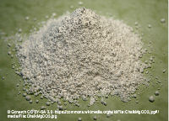
There are 3 basic reactions that should be memorised.
A carbonate can be a hydrogen carbonate or a metal carbonate - they undergo the same basic reaction.

Slide 16
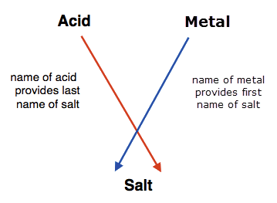
Acids produce specific salts e.g.
Hydrochloric acid produces a chloride salt.
Sulfuric acid produces a sulfate salt.
Nitric acid produces a nitrate salt.

Slide 17
Metals, carbonates and bases keep the same name e.g.
Magnesium metal produces a magnesium salt.
Calcium carbonate produces a calcium salt.
Sodium hydroxide produces a sodium salt.

Slide 18

Let's try writing our own word equation for this reaction:
Hydrochloric acid and sodium carbonate are combined in a beaker.
Firstly, just write the reactants which are given in the question:
hydrochloric acid + sodium carbonate →

Slide 19

Secondly, work out what salt will form; from hydrochloric acid and sodium carbonate, the salt will be sodium chloride.
Finally, add in the other products as specified in the acid + metal carbonate equation, water and carbon dioxide.
Putting that all together gives us:
hydrochloric acid + sodium carbonate → sodium chloride + water + carbon dioxide

